Slide 1
Earthquakes
Forces

Slide 2
What causes Earthquakes
Stress
Strain

Slide 3
What are earthquakes?
Natural vibrations on the ground caused by movement along gigantic fractures in Earth’s crust

Slide 4
Stress and Strain
When do most earthquakes occur?
When rocks break (fracture) deep in the Earth
When do fractures form?
When stress exceeds (goes past) the strength of the rocks involved.
The stress is stronger than the rock's ability to hold on

Slide 5
What is stress?
The forces per unit area acting on a material
EX: pounds per square inch

Slide 6
Three types of stress...
Compression: decreases the volume of a material - occurs at convergent boundaries
Tension: pulls a material apart - at divergent boundaries
Shear (horizontal): causes a material to twist - at transform boundaries

Slide 7
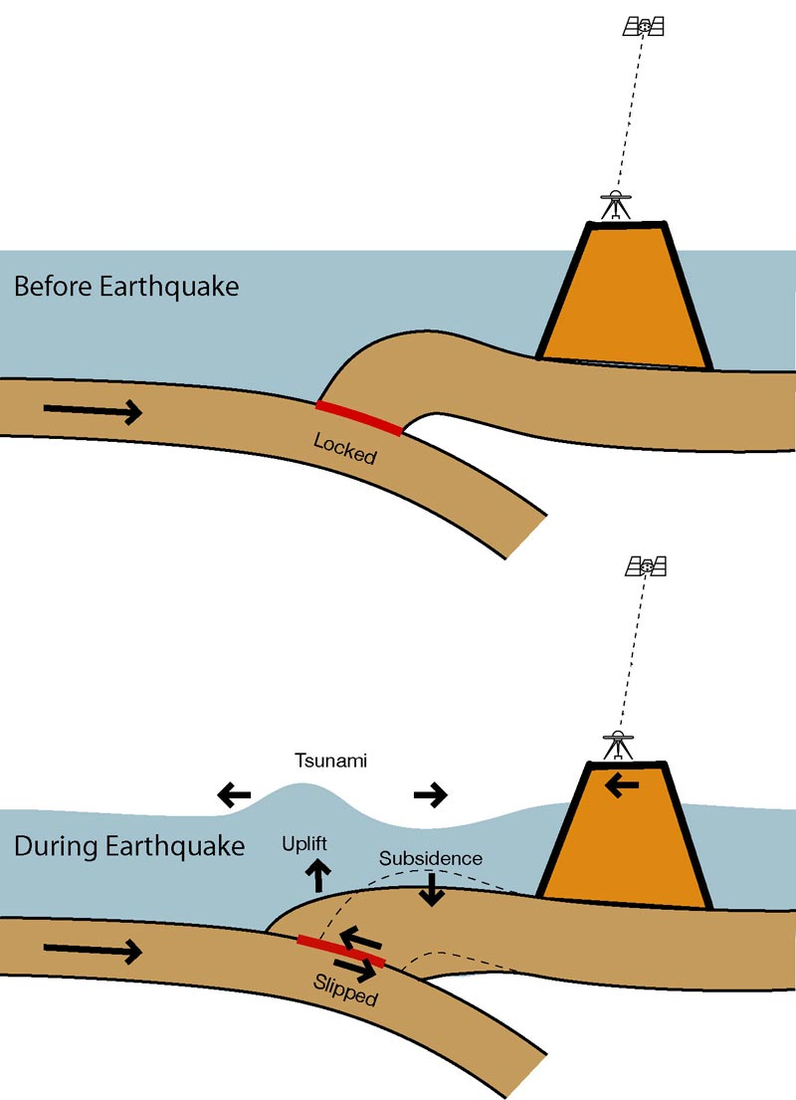
What is strain?
The deformation of materials in response to stress

Slide 8
Elastic Limit
A slab of rock’s elastic limit is the point at which it will undergo permanent deformation
At Failure a material breaks
This is when we get an earthquake

Slide 9
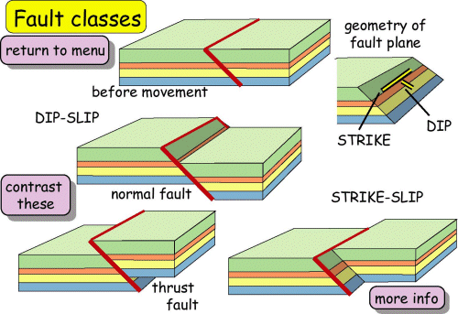
Faults
Rocks fail and forma fault when stress is applied too quickly or when stress is too great.
Fault is the resulting fracture or system of fractures along which movement occurs.

Slide 10
Reverse Fault
Caused by compression

Slide 11
Normal Fault
Caused by tension

Slide 12
Strike-slip Fault
Caused by horizontal shear
No vertical movement

